Slide 1
Project Status Report
TEXT LINE EXTRACTION FROM PRINTED KANNADA DOCUMENTS
Internal Guide ,
Dr. Mamatha HR
Professor
Department of ISE
PESIT
Bangalore
Presentation By,
Prajna R
Ramya V.R
Department of ISE
PESIT
Bangalore
Notes:
This template can be used as a starter file to give updates for project milestones.
Sections
Right-click on a slide to add sections. Sections can help to organize your slides or facilitate collaboration between multiple authors.
Notes
Use the Notes section for delivery notes or to provide additional details for the audience. View these notes in Presentation View during your presentation.
Keep in mind the font size (important for accessibility, visibility, videotaping, and online production)
Coordinated colors
Pay particular attention to the graphs, charts, and text boxes.
Consider that attendees will print in black and white or grayscale. Run a test print to make sure your colors work when printed in pure black and white and grayscale.
Graphics, tables, and graphs
Keep it simple: If possible, use consistent, non-distracting styles and colors.
Label all graphs and tables.

Slide 2
Agenda
Introduction
Problem Definition
Motivation
Literature Survey
About Data Set
Method Explanation
Comparative Study
Conclusion
Future Enhancements

Slide 3
Introduction
An Optical Character Recognition (OCR) system is the process of transforming human readable and optically sensed data to machine understandable codes.
OCR system has the following steps :
OCR System
Image Acquisition
Pre-processing
Segmentation
Feature Extraction
Classification and Recognition

Slide 4
Problem Definition
Segmentation is an important task of any Optical Character Recognition (OCR) system.
Segmentation is the process of extracting objects of interest from an image.
“Text line extraction from printed Kannada documents” is the first step in segmentation process.
For the extraction of lines we have implemented three segmentation methodologies.

Slide 5
Motivation
Efficient OCR systems for Kannada are one of the present day requirements.
Line segmentation is very important for further process.
Not many works are reported for Printed Kannada documents.
Notes:
Sunny Buffalo university

Slide 6

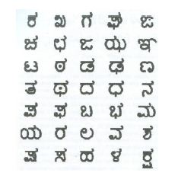
Characteristics Of Kannada Script Includes 16 vowels and 35 consonants Vowels in Kannada script Consonants in Kannada script

Slide 7
Consonant-vowel composite characters of first consonant Conjunct Consonant (Subscript/Vatthu)

Slide 8
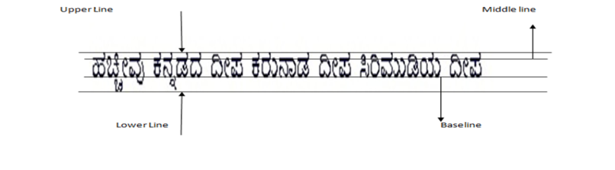
Text Line Components
Baseline: fictitious line which follows and joins the lower part of the character bodies in a text line .
Upper line: fictitious line which joins the top of ascenders.
Lower line: fictitious line which joins the bottom of descenders.

Slide 9
Literature Survey
Author | Name Of the Paper | Method Used For Text Line Segmentation | Accuracy
R Sanjeev Kunte and R D Sudakher Samuel | An OCR system for printed Kannada text using Two-stage Multi-network classification approach employing Wavelet features | Horizontal Projection | 92%
Mamatha H R and Srikantamurthy K | Morphological Operations and Projection Profiles based Segmentation of Handwritten Kannada Document | Morphological Operations and Projection Profiles | 94.5%

Slide 10
Data Set
Data set is generated through Baraha software.
Single column documents are considered for line extraction.
Different documents with different font style and different font sizes are considered for extraction of lines.
Documents contains lines in range 14-24.

Slide 11
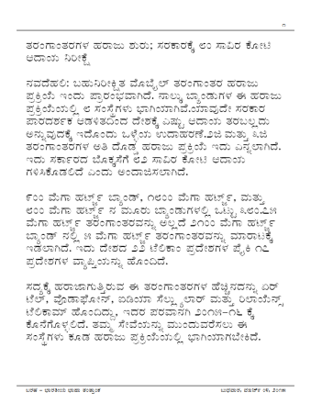
Sample Documents Original Image with font style BRHKannada and font size 22

Slide 12
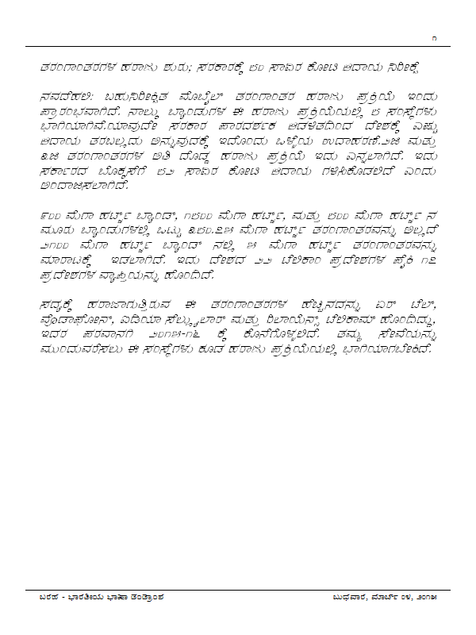
Original Image with font style BRHAmerikannda and font size 16

Slide 13
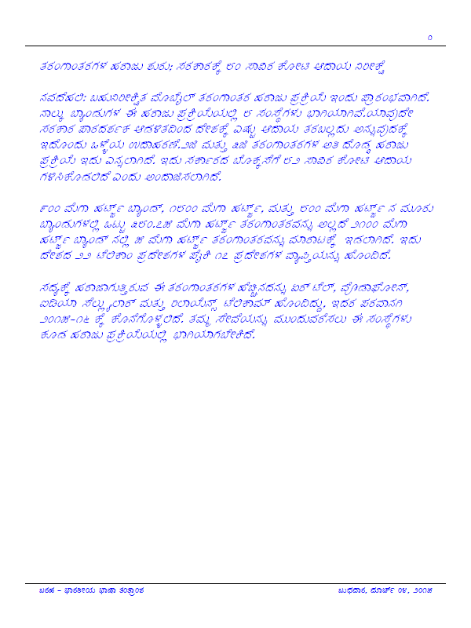
Original Image with font style BRHBenguluru and font size18

Slide 14
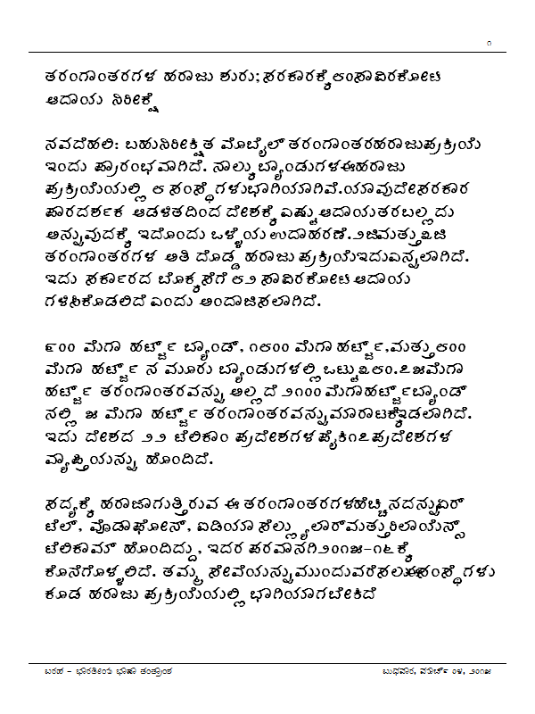
Original image with font style BRHkailasm and font size 18

Slide 15
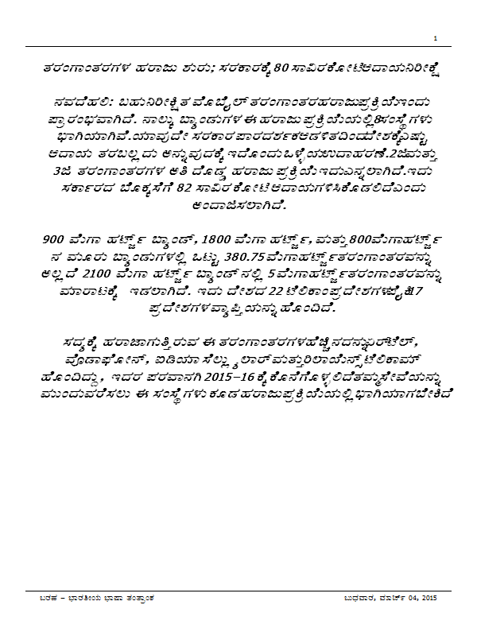
Original Image with font style BRHKannadaRN and font size 7

Slide 16
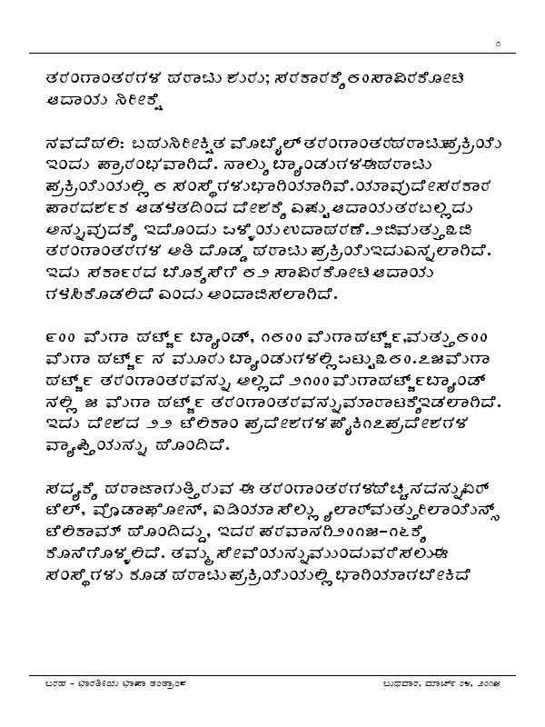
Original Image with font style BRHSrigandha and size 14

Slide 17
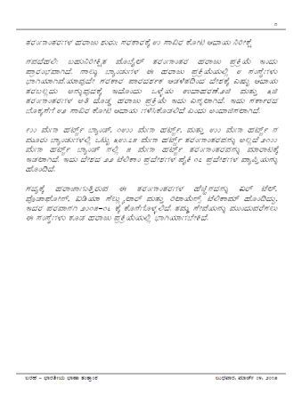
Original Image with font style BRHVijay and size 16

Slide 18
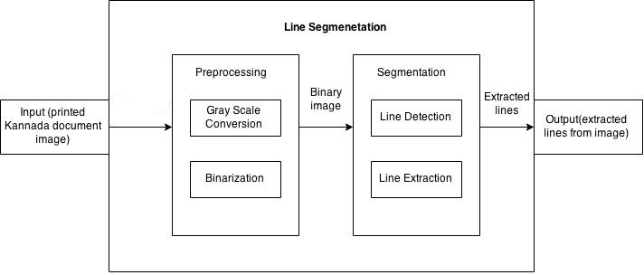
System Design

Slide 19
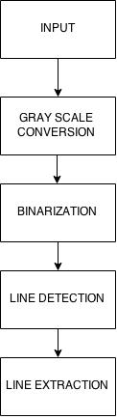

Data Flow Diagram
Preprocessing
Segmentation

Slide 20
Preprocessing
Gray Scale Conversion
a grayscale image is an image in which the value of each pixel is a single sample, that is, it carries only intensity information.

Slide 21
Binarization
Image binarization converts an image to a black and white image. Frequently, binarization is used as a pre-processor before OCR.
The simplest way to use image binarization is to choose a threshold value, and classify all pixels with values above this threshold as white, and all other pixels as black.

Slide 22
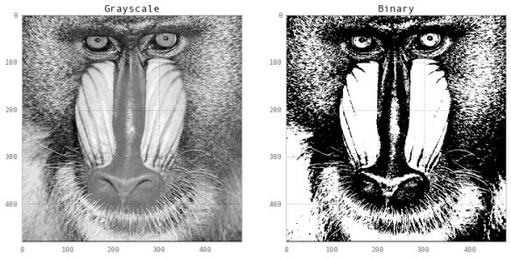
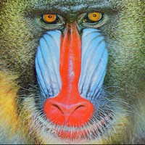
Example
Original Image Gray scale Binary

Slide 23
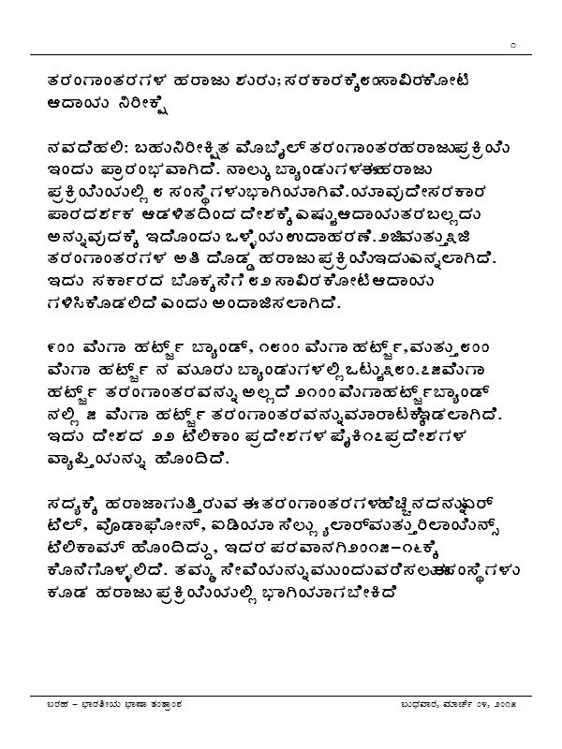
Original Image

Slide 24
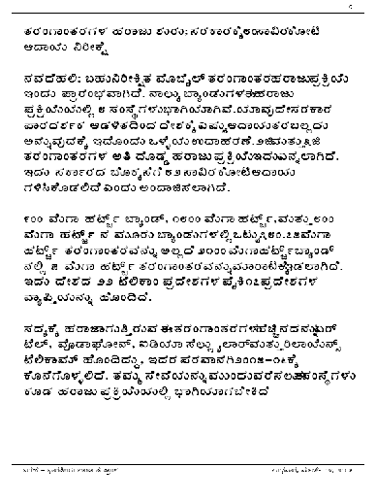
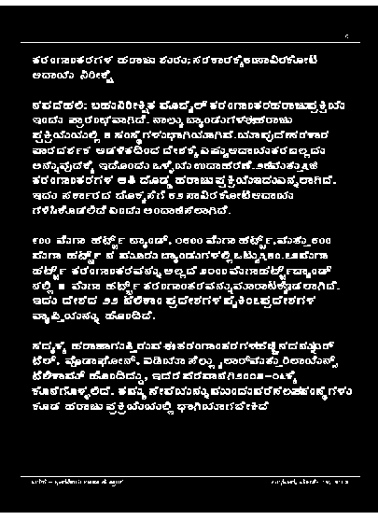
Gray Scale and Binary Image

Slide 25
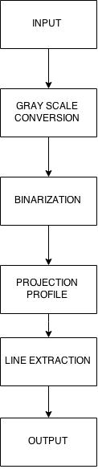
Horizontal Projection Profile
Data Flow Diagram:
PREPROCESSING
PROJECTION
TECHNIQUE
& EXTRACTION

Slide 26
Algorithm
Algorithm
Begin
Input: Printed Kannada text document
Output: Segmented lines
Method:
Step 1: Binarize the original image.
Step 2: Find the minimum and maximum positions of the zero valued
pixels to identify the rows. Step 3: Horizontal projection is applied for line segmentation
End

Slide 27
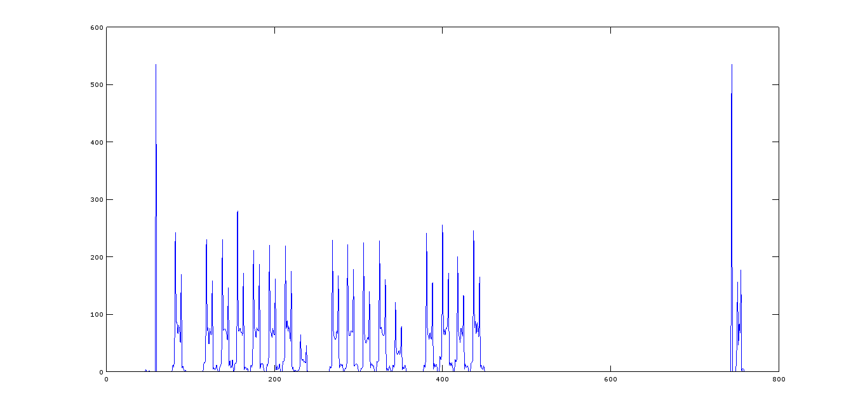
Horizontal Projection Profile Boundary line

Slide 28
Original Image with font style BRH Amerikannada and font size 16

Slide 29
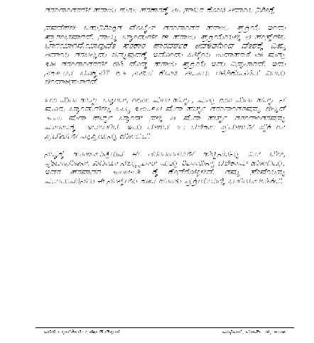
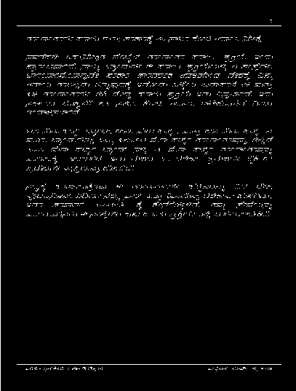
Gray Scale and Binary image

Slide 30
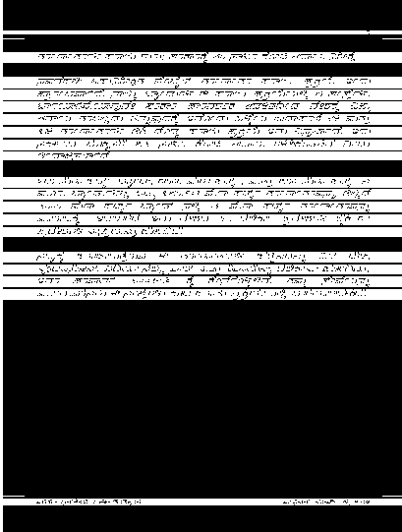
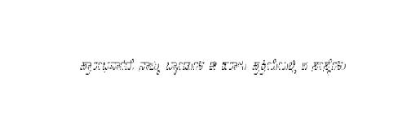
Detected and Extracted line

Slide 31
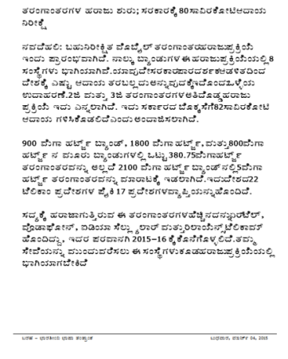
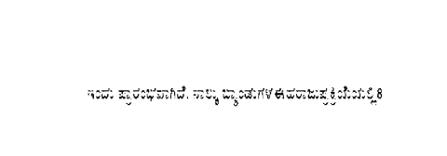
Original Image with font style BRH Kannada & font size 22 and extracted line

Slide 32
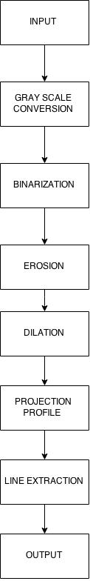
Morphology Based Approach
Data Flow Diagram:
PREPROCESSING
MORPHOLOGY
OPERATIONS
PROJECTION AND
EXTRACTION

Slide 33
Image Morphology
Morphology is a tool for extracting image components that are useful in the representation and description of region shape, such as boundaries and skeletons.
Two basic Morphology operations:
Dilation: primitive morphological operation that grows or thickens objects in a binary image
Erosion: shrinks or thins objects in a binary image

Slide 34
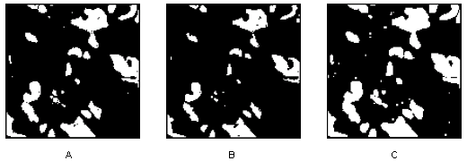
Example Binary Image Erosion Dilation

Slide 35
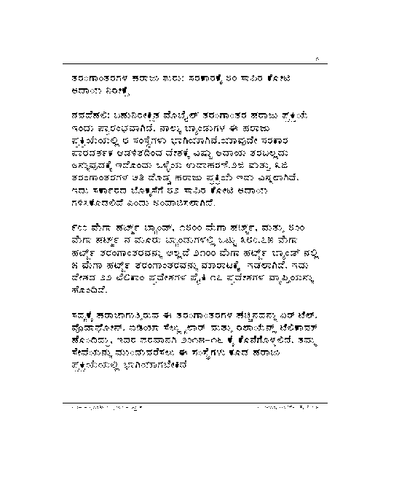
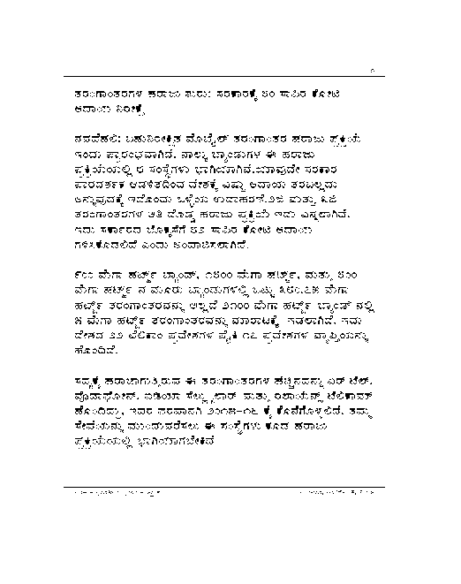
Erode and Dilated Image

Slide 36
Algorithm
Algorithm
Begin
Input: Printed Kannada text document
Output: Segmented lines
Method:
Step 1: Binarize the original image.
Step 2: Erosion followed by dilation operations are applied
Step 3: find the minimum and maximum positions of the zero valued
pixels to identify the rows
Step 4: Horizontal projection is applied for line segmentation
End

Slide 37
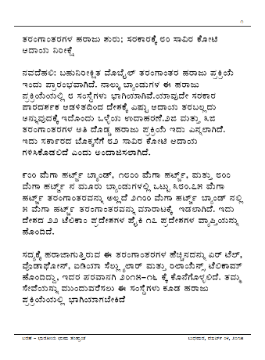
Original Image with font style BRH Kannada and font size 25

Slide 38
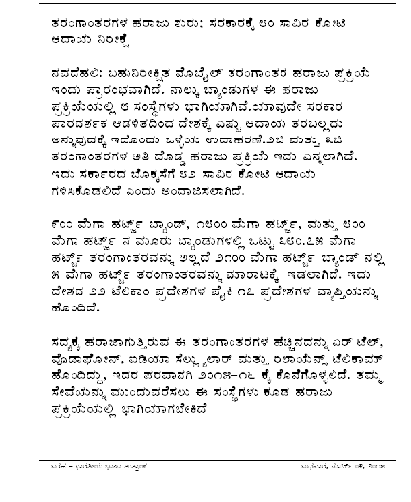
Grayscale Image

Slide 39
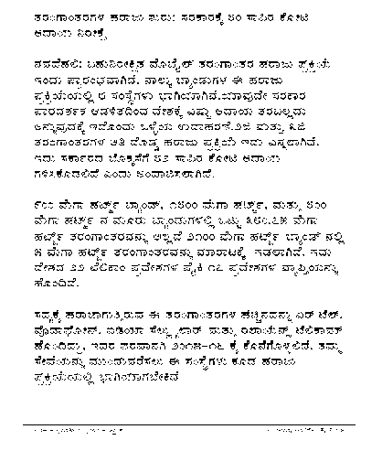
Binary image

Slide 40
Eroded and Dilated image

Slide 41
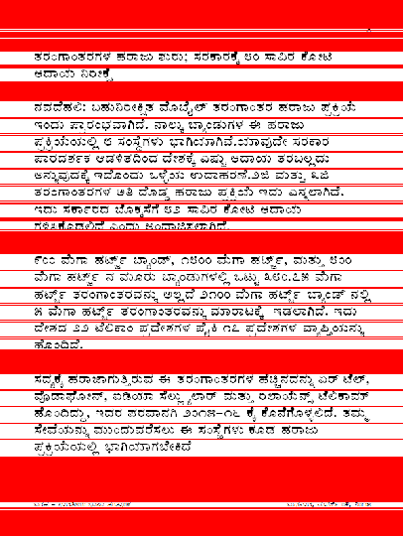
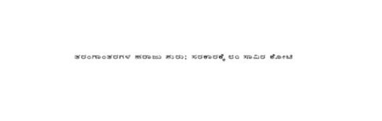
Detected and Extracted line

Slide 42
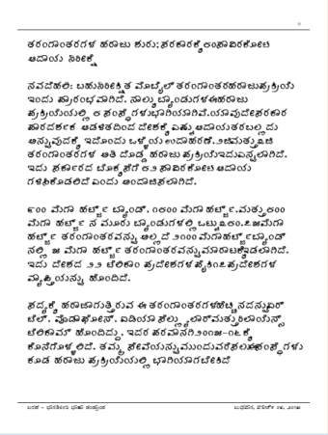
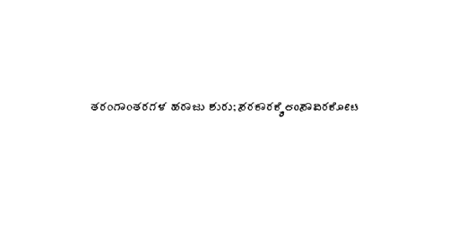
Original Image with font style BRH kailasam,fontsize 20 and Extracted line

Slide 43
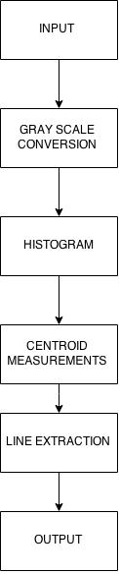
Bounding Box Approach Data flow diagram:
PREPROCESSING
BOUNDING BOX
TECHNIQUE
& EXTRACTION

Slide 44
Algorithm
Algorithm
Begin
Input: Printed Kannada text document
Output: Segmented lines
Method:
Step 1: Convert the original image to gray scale.
Step 2: Histogram is plotted and white spaces are found
Step 3: find centroids of white gaps
Step 4: Measurements of centroids is found using regionprops and
lines are cropped using the measurements of centroids
End

Slide 45
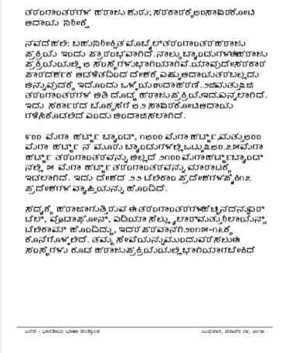
Original Image with font style BRH Amerikannada and font size 26

Slide 46
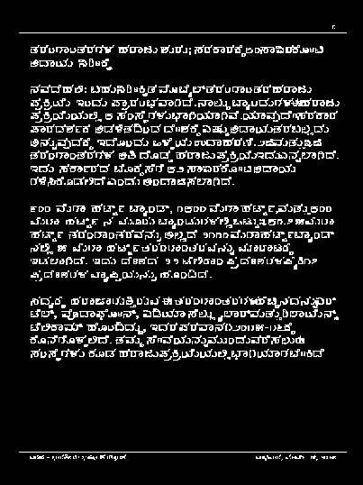
Binary image and Extracted line

Slide 47
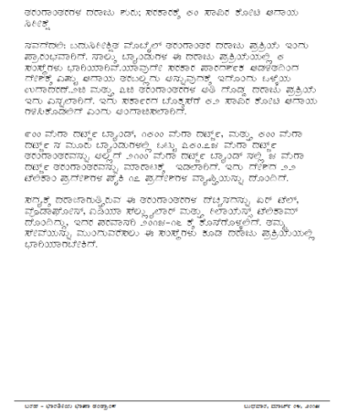
Original Image with font style BRH Srigandha, font size 25 and Extracted Line

Slide 48
Comparative Study
Author | Segmentation Method | Size of dataset | Segmentation rate (%)
R Sanjeev Kunte et al.,[7] | Horizontal Projection based approach | 20 | 92
Proposed Method 1 | Horizontal Projection based approach | 35 | 84
Proposed Method 2 | Morphological operations and projection profile based approach | 35 | 86
Proposed Method 3 | Bounding Box based approach | 35 | 80

Slide 49
Conclusion
Accuracy obtained from the proposed method is reduced because we have considered different documents with different font sizes such as 15,25,28 and different font styles such as kailasam,vijaya etc.
If the accuracy of line segmentation is less than the accuracy of word and character segmentation reduces,eventually the extracted characters will be misinterpreted in OCR.

Slide 50
Future Enhancements
Use of double column documents
Single document with different font styles and font sizes
Word and character extraction

Slide 51
References
[1] Nallapareddy Priyanka, Srikanta Pal, Ranju Mandal “Line and Word Segmentation Approach for Printed Documents”, IJCA Special Issue on “Recent Trends in Image Processing and Pattern Recognition”RTIPPR, 2010.
[2] Sunanda dixit,Suresh Hosahalli Narayana,Mahesh Belur “Kannada text line extraction based on energy minimization and skew correction”.
[3] B. Gangamma, Srikanta Murthy K, Riddhi J. Shah, Swati D V “Text Line Extraction from Palm Script Documents Using Morphological Approach”
[4] Vikas J Dongre , Vijay H Mankar “Devnagari document segmentation using histogram approach”.International Journal of Computer Science, Engineering and Information Technology (IJCSEIT), Vol.1, No.3, August 2011
[5] Alireza Alaei, P. Nagabhushan, Umapada Pal “A Benchmark Kannada Handwritten Document Dataset and its Segmentation” 2011 International Conference on Document Analysis and Recognition.

Slide 52
[6] U. Pal and B. B. Chaudhuri “Script Line Separation From Indian Multi-Script Documents”.In Proc. 4thICDAR.
[7] R. Sanjeev Kunte, R. D. Sudhaker Samuel An OCR system for printed Kannada text using Two-stage Multi-network classification approach employing Wavelet features”,International Conference on Computational Intelligence and Multimedia Applications 2007.
[8] Mamatha Hosalli Ramappa and Srikantamurthy Krishnamurthy “Skew Detection, Correction and Segmentation of Handwritten Kannada Document”,International Journal of Advanced Science and Technology Vol. 48, November, 2012.
[9] M.RaviKumar, R.Pradeep,B.S.PuneethKumar,Prasad Babu“A Simple Text-line segmentation Method for Handwritten Documents”, IJCA Proceedings on National Conference on Advanced Computing and Communications 2012NCACC(1):46-61, August 2012.
[10] G. Louloudi1, B. Gatos, I. Pratikakis, C. Halatsis. “Line And Word Segmentation of HandwrittenDocuments”,Proceedings of the1st International Conference on Frontiers in Handwriting Recognition (ICFHR), 247-252.

Slide 53
[11]M.Ravi Kumar, R. Pradeep, B.S.PuneethKumar,PrasadBabu“A Simple Text-line segmentation Method for Handwritten Documents”, IJCA Proceedings on National Conferecne on Advanced Computing and Communications 2012NCACC(1):46-61, August 2012.
[12] Mamatha H R, Srikantamurthy K “Morphological Operations and Projection Profiles based Segmentation of Handwritten Kannada Document” International Journal of Applied Information Systems (IJAIS) – ISSN : 2249-0868 Foundation of Computer Science FCS, New York, USA Volume 4– No.5,October 2012 – www.ijais.org

Slide 54
Paper Work
Based on the work done for the project,we have written paper named- A Study of different Text Line Extraction Techniques for Multi-font and Multi-size Printed Kannada Documents.
Uploaded to IJCA(International Journal of Computer Applications) june 2015

Slide 55


